Slide 1

-
Team Details
Team name: Data Driven Droids
Team leader name: Utkarsh Tripathi
Problem Statement: Enhancing City Infrastructure with Data-Driven Decisions

Slide 2
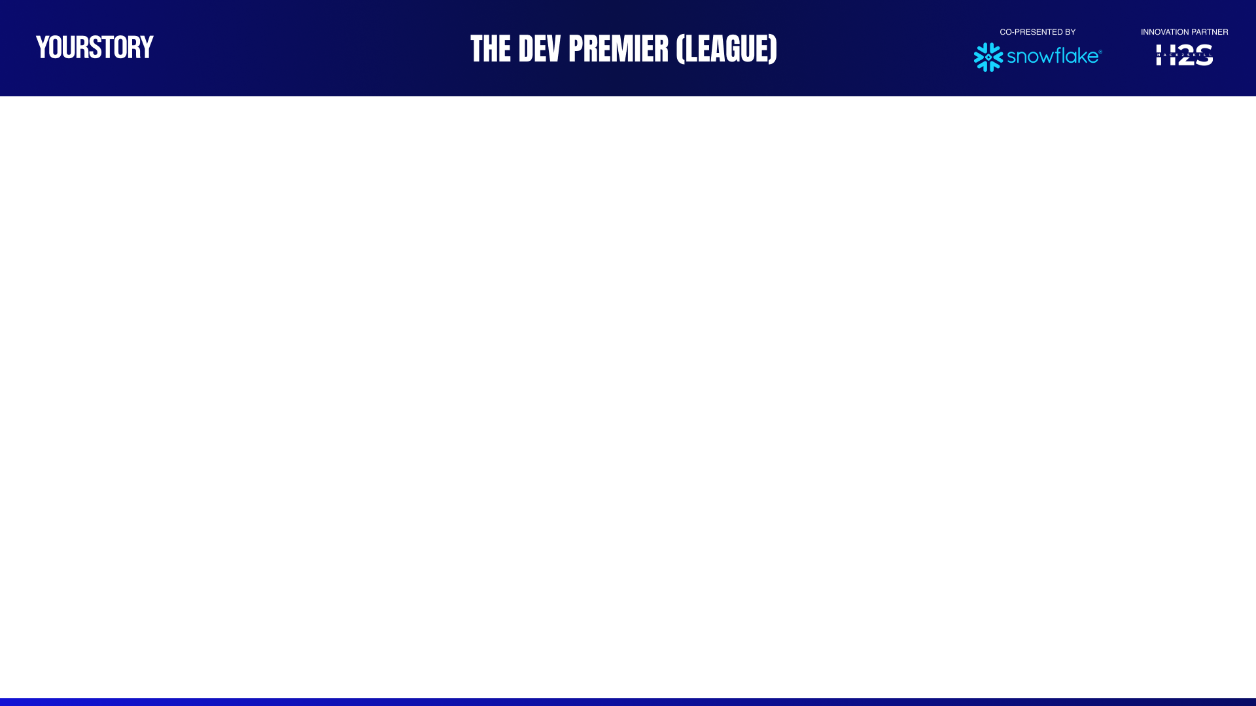
xAZ
Agenda
Brief Overview of Problem Statement and Solution
Tools, Data Sources and Technologies Used
Architecture
Demo
Future Enhancements
Monetization of the Solution

Slide 3
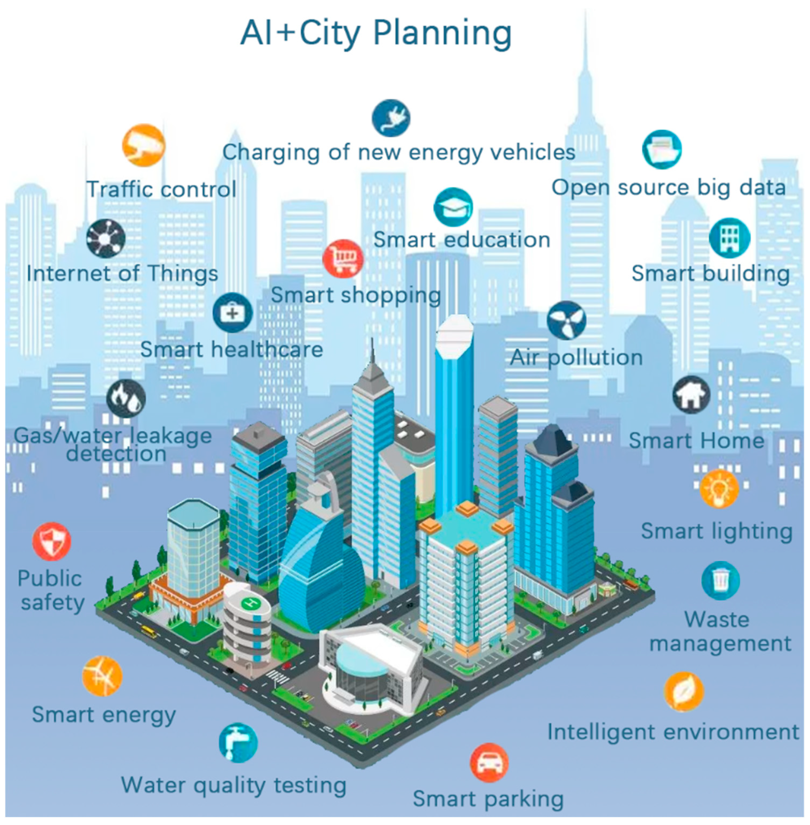
xAZ
Brief about the idea
System: Web application
Data Sources: News API, 511 NYC, NYC Open Data, NYC311 Data, Weather API
Target City for Prototype: New York, USA
User persona: It will be primarily used by Civic Planners, City Residents and Public Officials
Functionality: The app/ website will have the following key modules as listed below
Functional usage: Our platform uses AI to create a safer, more efficient city. For city planners, it offers predictive insights for smarter budgeting and proactive maintenance. For residents, it provides real-time traffic solutions, instant emergency alerts, and easier access to city services, fostering a more responsive and connected community for all.
Technology used: Python, Snowflake Tables, Materialized Views, Snowflake Cortex Analyst, Snowflake Cortex Search, Snowflake Cortex Agents, Snowflake Intelligence, GCP, Fast API, Streamlit
Smart Street
Urban SoS
City Guard Service
Bin Sync Service
UtiliGen Service
City 360 Scope dashboard
Resilient Cities
Notes:
Our platform is designed to benefit everyone: making the city run smoother for officials, and making life easier for residents.
For city planners, we use powerful Artificial Intelligence to look at massive amounts of city data—from 311 calls to weather reports—and predict problems. This helps them fix infrastructure and budget money before issues arise, leading to smarter maintenance and savings.
For the everyday New Yorker, it provides essential tools like real-time traffic solutions, instant emergency alerts through our Urban SoS module, and one simple place to find city services.
We utilize the latest data technology, integrating all public city data sources with powerful AI tools from Snowflake

Slide 4
-
Solution Modules Overview - Screenshots and Overview

Slide 5
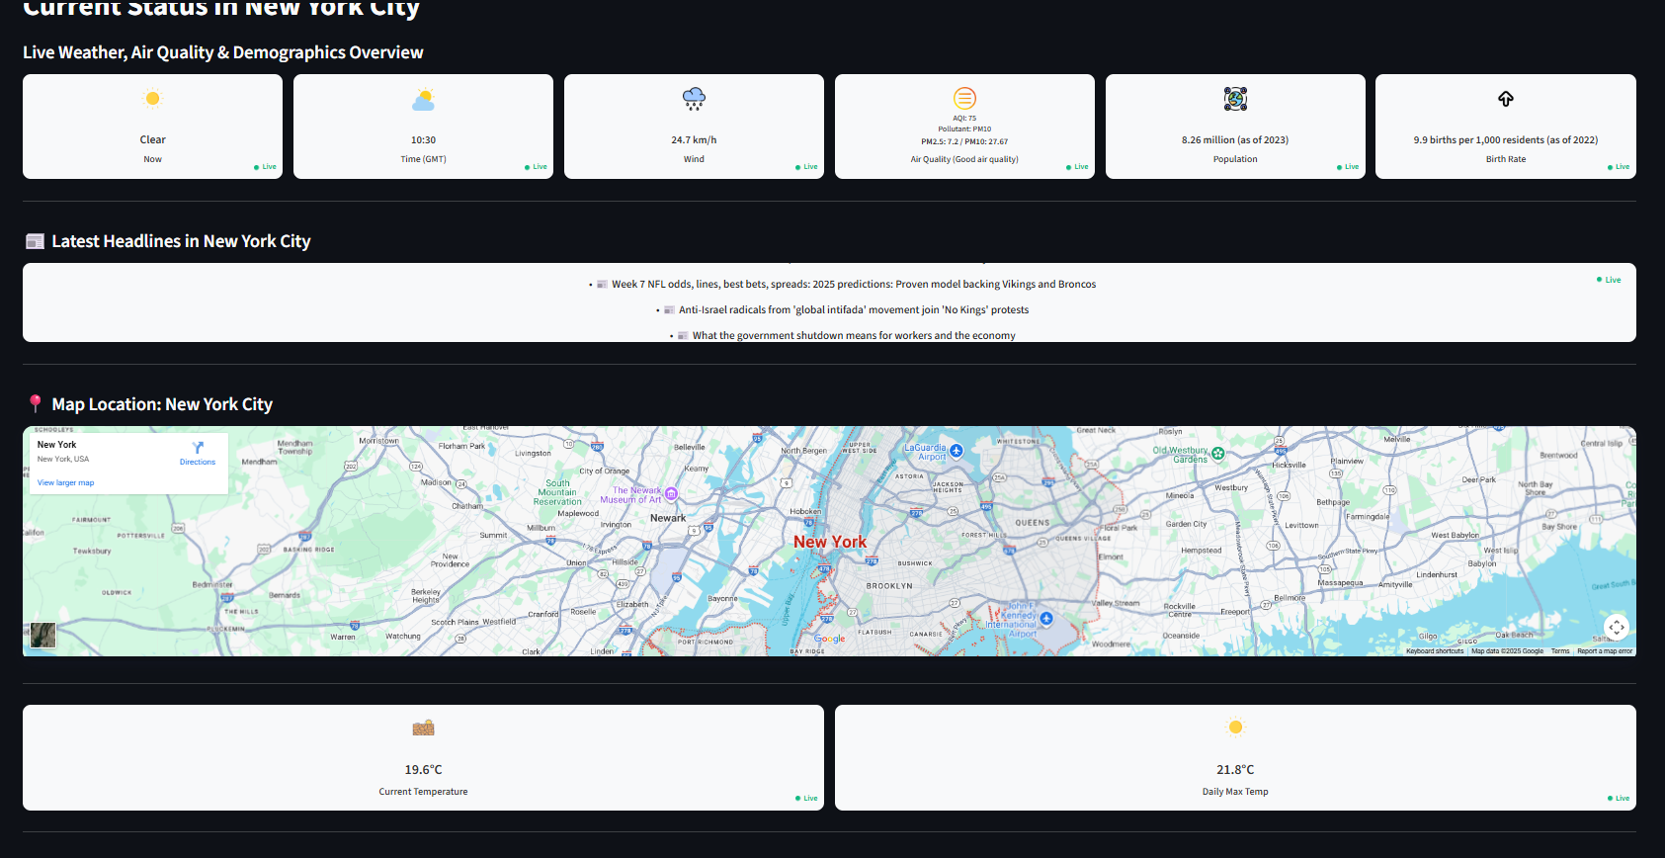
Solution Module – Home Page
https://nyc-360-558345184877.europe-west1.run.app/
Detailed Weather Forecasting: The homepage features comprehensive weather analysis, including an hourly graph plotting humidity and temperature, alongside a 7-day future forecast detailing Max/Min temperatures and UV index.
Current Status Overview: The "Current Status" section provides a holistic overview of New York City, displaying live weather conditions, current air quality (AQI), and key demographics like population and birth rate.
Location and News Integration: Users can view the city's location via an embedded map displaying current and maximum daily temperatures, followed by a dynamic section for the "Latest Headlines" news feed.

Slide 6
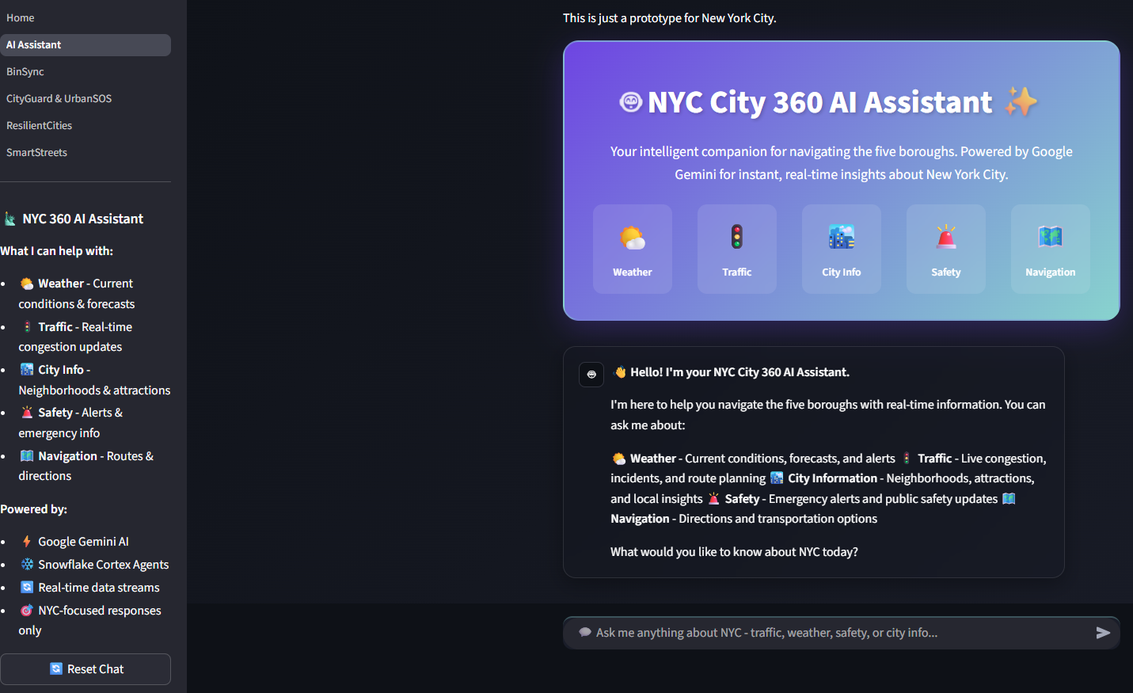
Solution Module – NYC Assistant Chatbot
https://nyc-360-558345184877.europe-west1.run.app/AI_Assistant
Comprehensive NYC Companion: Positioned as an "intelligent companion," the NYC 360 AI Assistant is ready to answer virtually any user query about navigating, living, or finding information within the five boroughs.
Modular Functionality: While offering broad knowledge, the assistant organizes its data into five core modules: Weather, Traffic, City Info, Safety, and Navigation, providing specialized, real-time insights.
Advanced AI Backbone: The system is powered by Google Gemini AI and leverages Snowflake Cortex Agents, ensuring sophisticated processing and delivery of accurate, highly relevant, NYC-specific responses.

Slide 7
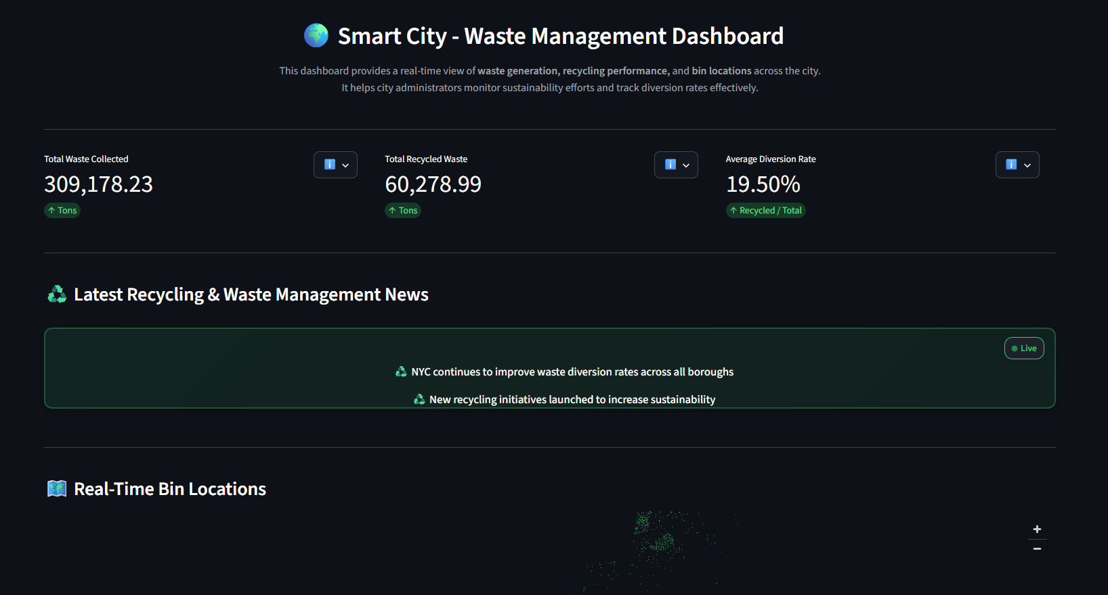
Solution Module – Smart Waste Management System
https://nyc-360-558345184877.europe-west1.run.app/BinSync
Performance Metrics: The dashboard provides real-time KPIs for waste generation and recycling performance, showing metrics like total waste collected, total recycled waste, and the current 19.50% diversion rate.
Location Mapping and Data: A geographical map visualizes the real-time locations of collection bins across the city. Detailed raw data lists specific bin names, boroughs, types (like electronics drop-off), and coordinates.
Historical Trend Analysis: The dashboard tracks 12-month trends, visualizing the historical performance of total waste versus recycled waste. Key highlights summarize current and rolling average waste diversion rates.

Slide 8
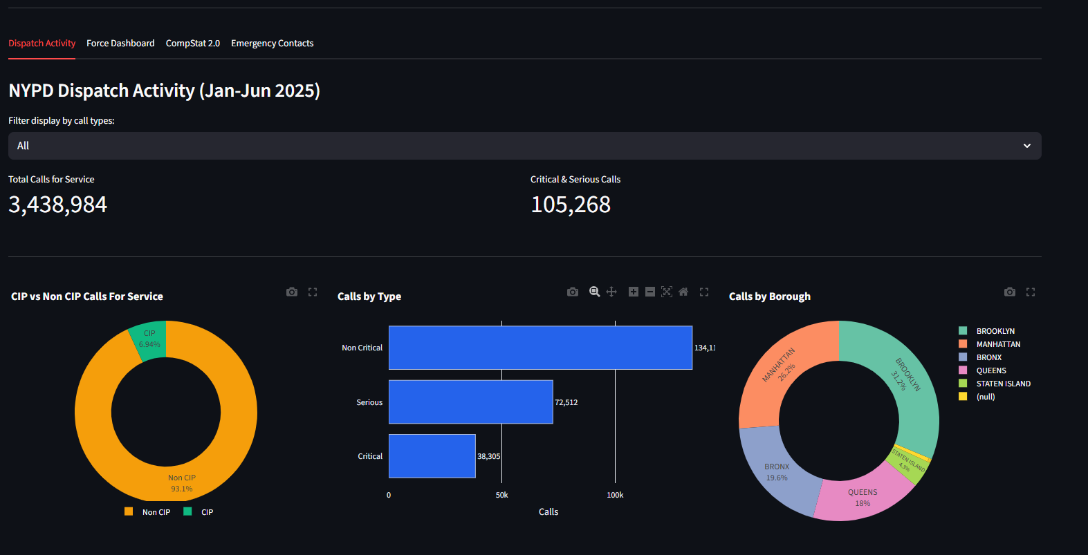
Solution Module – Urban SoS and City Guard Service
https://nyc-360-558345184877.europe-west1.run.app/CityGuard_&_UrbanSOS
NYPD Dispatch Analytics: This section visualizes over 3.4 million service calls, categorizing them by critical/non-critical status, type (e.g., Serious), and distribution across all boroughs.
Force & Incident Dashboard: Tracks NYPD use of force incidents, showing trends over time, type of force used, and demographics of those involved, along with police member rank distribution.
CompStat & Emergency Contacts: Provides a CompStat Book with crime statistics (like murder, robbery) and period-over-period changes, alongside a critical list of city-wide emergency and non-emergency contacts.

Slide 9
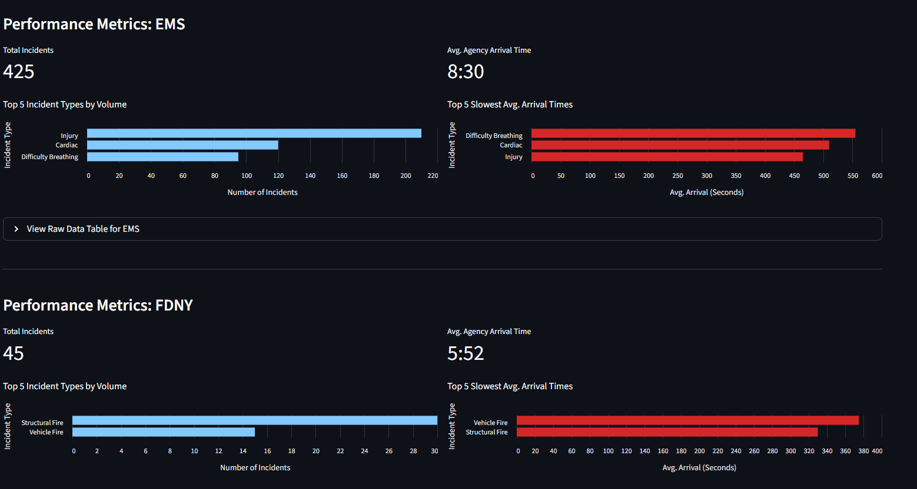
Solution Modules – Resilient Cities Dashboard
https://nyc-360-558345184877.europe-west1.run.app/ResilientCities
Emergency Response Metrics: Tracks weekly emergency response performance for EMS, FDNY, and NYPD, showing incident volumes, average arrival times, and the slowest response types.
Capital Projects Overview: Features an interactive dashboard detailing future development projects, including budget allocations, current phase, and completion forecasts across various city agencies.
311 Service Monitoring: Analyzes 311 service requests, showing the volume and change in top requests (e.g., Noise, Illegal Parking) over time, allowing for neighborhood-specific monitoring.

Slide 10
Solution Modules – Smart Streets Services
https://nyc-360-558345184877.europe-west1.run.app/SmartStreets
Real-time Traffic Monitoring: Displays key metrics for live traffic, including total active events, coverage area, and the breakdown of events by severity (Critical, Major, Moderate, Minor).
Visual Analytics and Mapping: Features a Traffic Analytics Dashboard for severity and event type distribution, a Live Congestion Map, and a Route Planning tool for quick navigation checks.
Detailed Event Reporting: Provides specific lists and alerts for active Congestion Hotspots and all Traffic Events/Incidents, including location details, start/end times, and severity levels.

Slide 11
-
Tools, Data Sources and Technologies Used
Architecture

Slide 12



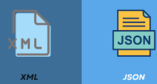
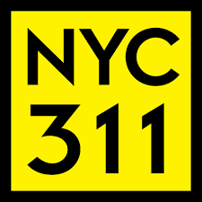
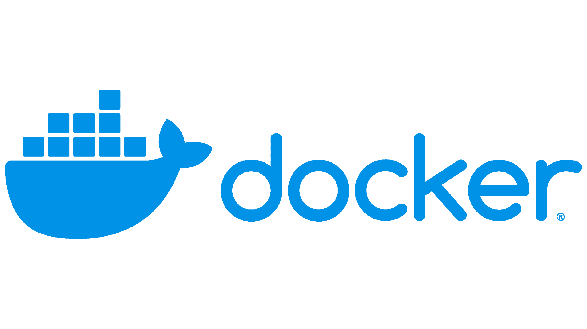



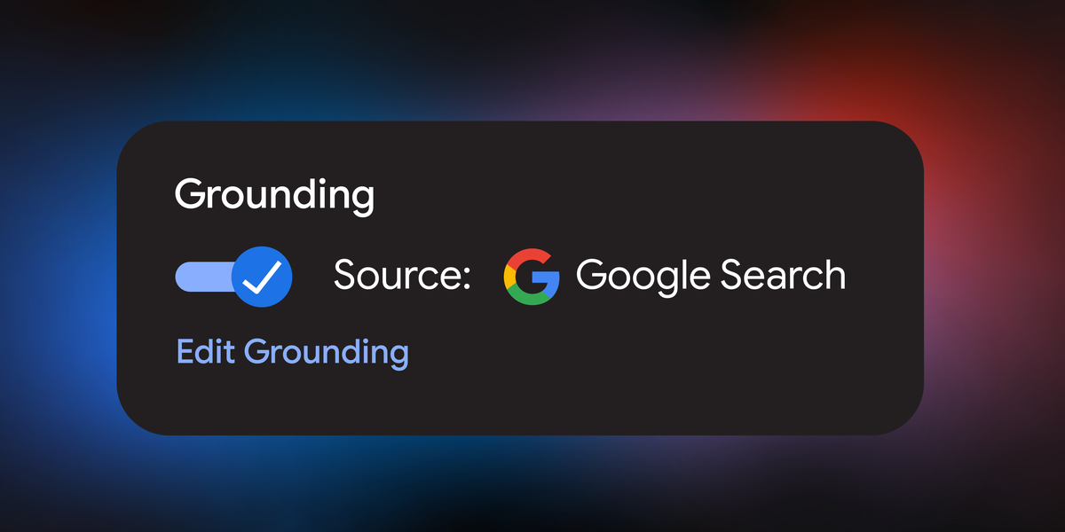

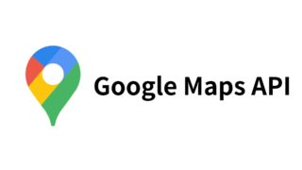
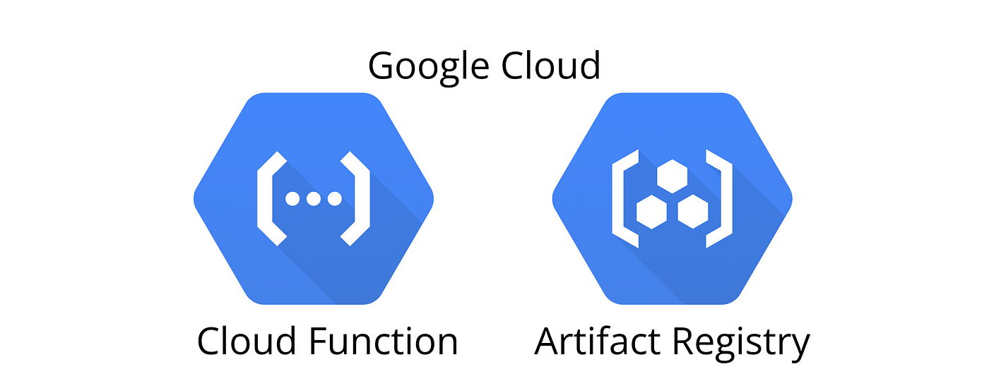



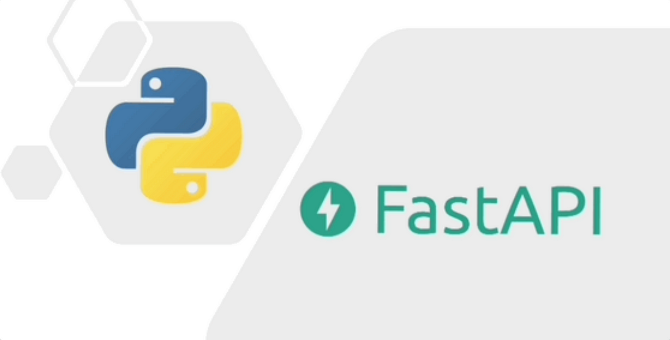

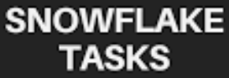
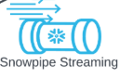

Technologies used in the solution
Tools/Data Sources Required
Interface
Production
Prototype
Backend
Notes:
You interact with the system through a simple, custom-built web application, which includes an AI chat assistant for easy access to information.
The heart of our solution is the massive amount of data we pull in. We integrate crucial, real-time public sources like NYC 311 complaints, 511 traffic feeds, city open data, and breaking news APIs.
All this data flows directly into the Snowflake Data Cloud. This is where the magic happens: we use Snowflake Cortex AI and Gemini Live API to analyze everything and perform complex tasks, essentially making our platform the intelligent brain of the city.
We rely on Python and have built this entire solution to be robust and scalable using modern cloud tools from Google Cloud, ensuring the app is always fast, secure, and ready for deployment in any major city.

Slide 13






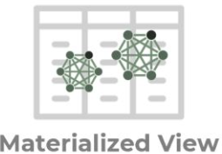
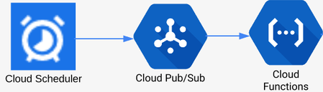



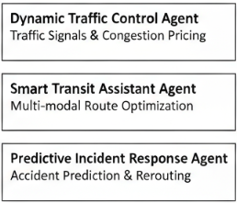
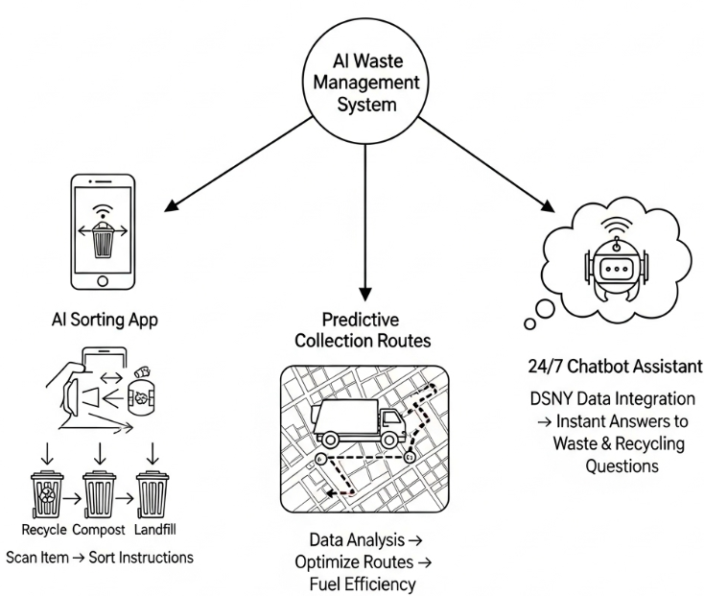
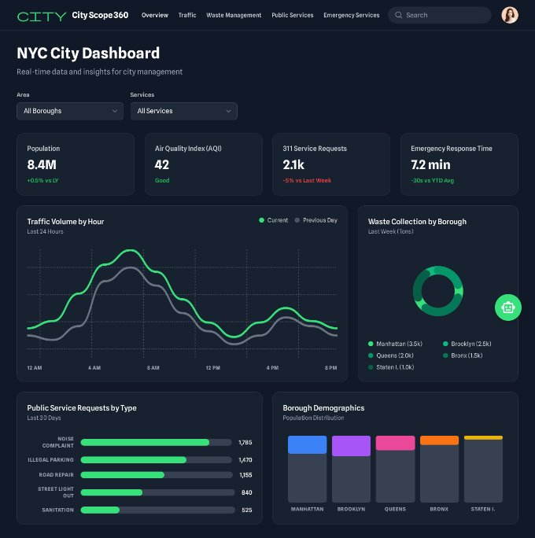
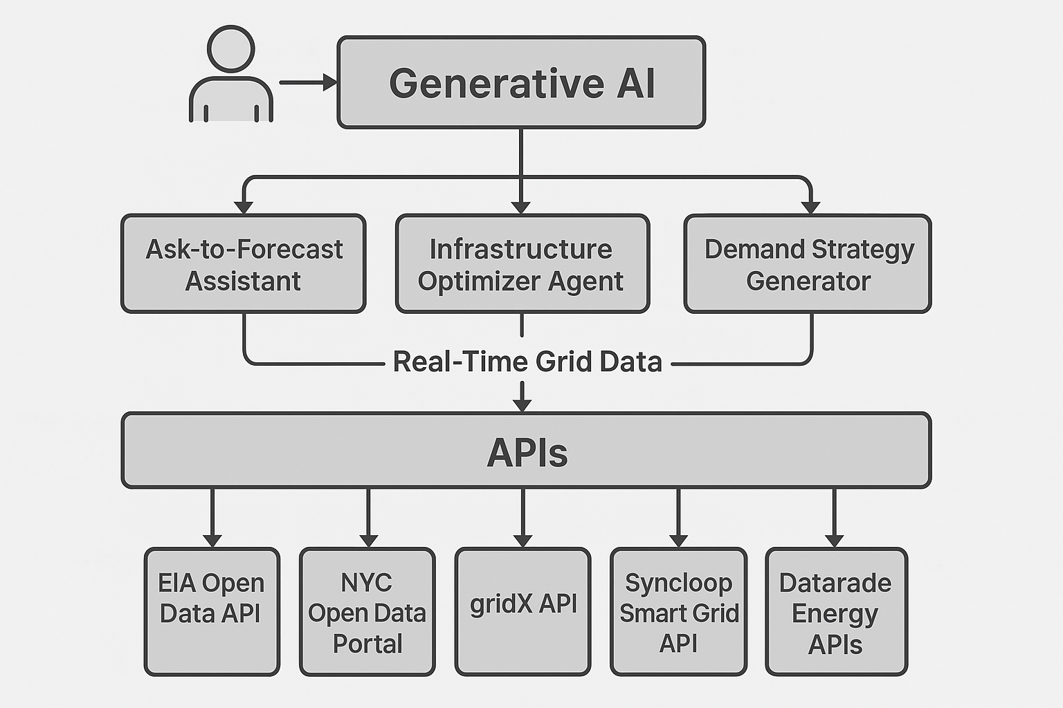
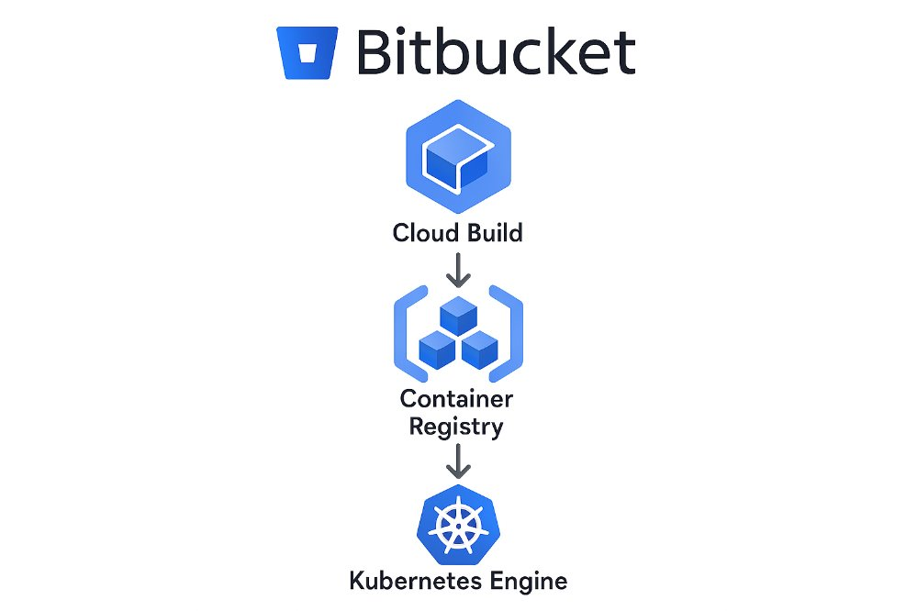
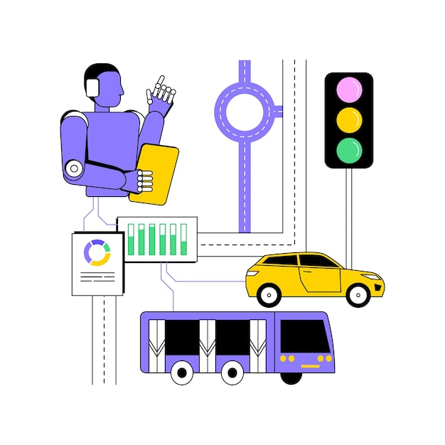


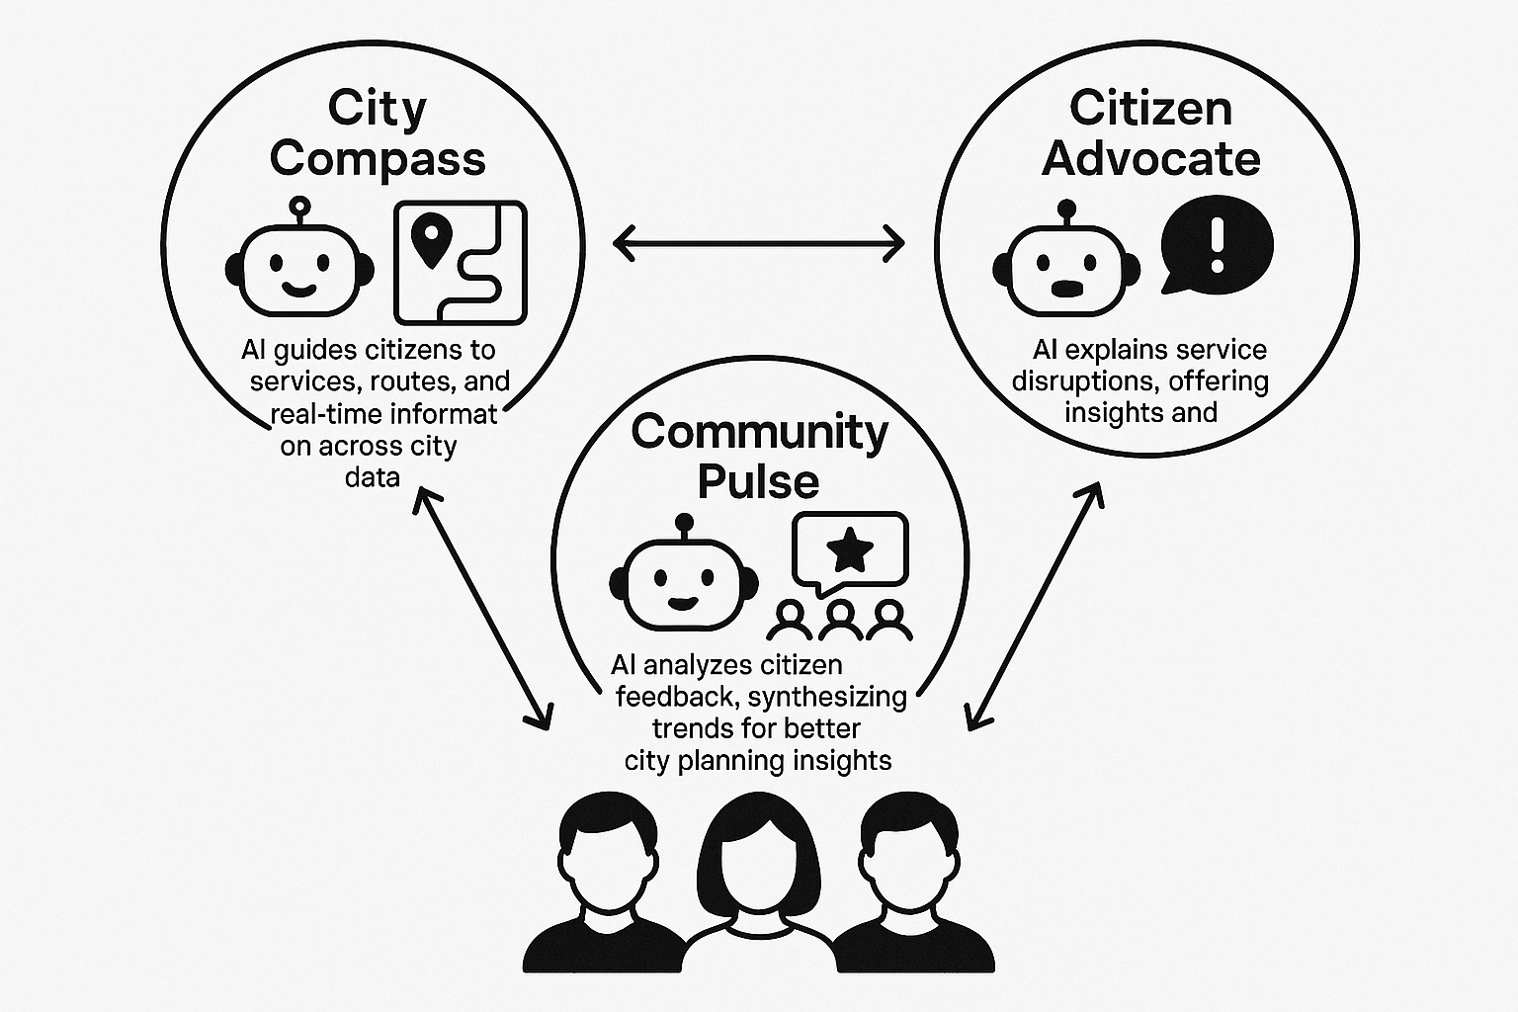
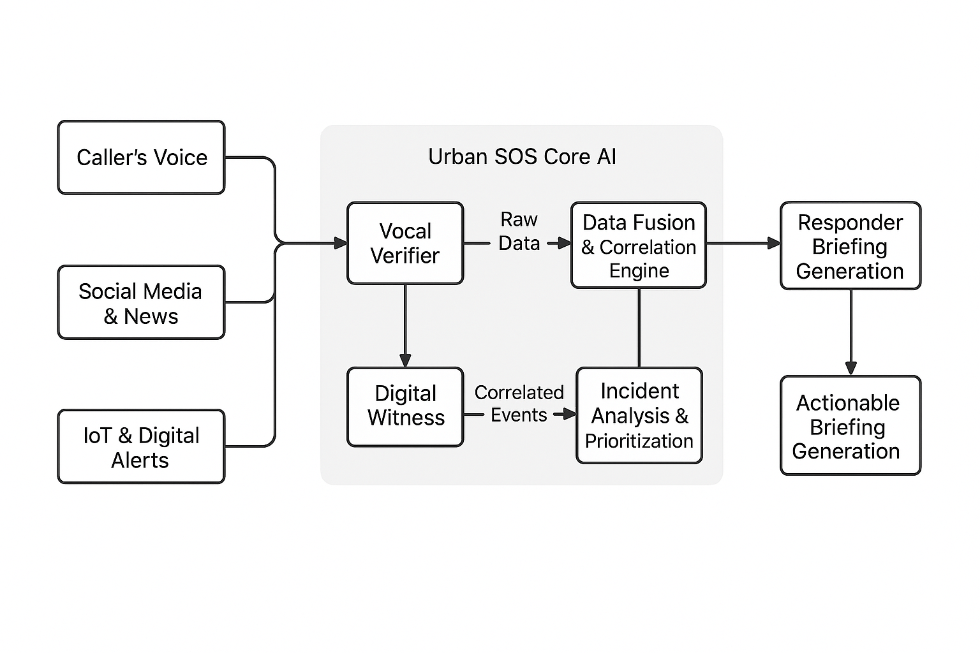
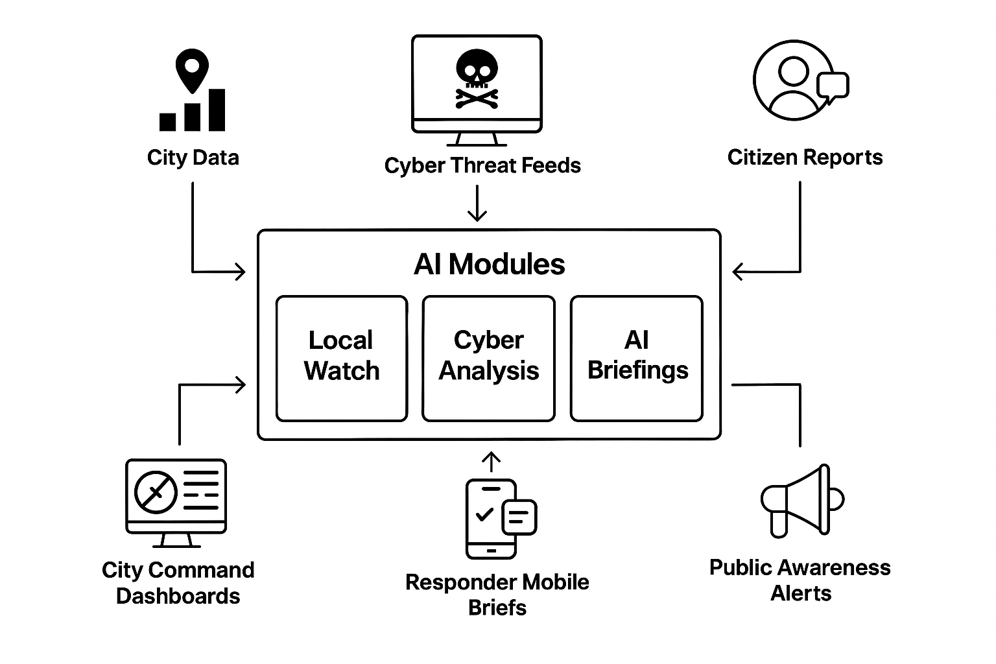
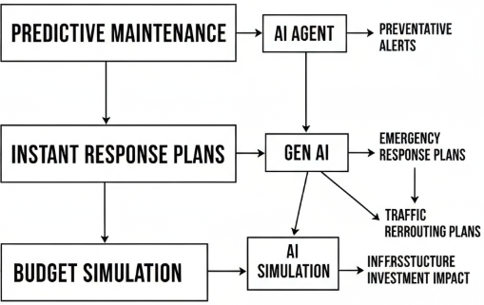

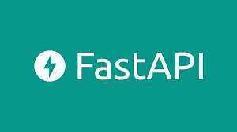
Architecture diagram of the proposed solution
Data Pipeline
Snow pipe
Raw tables
Curated tables
procedures
AI Framework
Feedback
Multi Agent Architecture
Deployment
Smart Street
Bin Sync Service
City 360 Dashboard
(Not in prototype)
Smart Watts
UI
UtiliGen Service
Urban SoS
City Guard
Resilient Cities
Tools Used
Notes:
This architecture diagram illustrates the end-to-end flow of our Smart City solution, showing how raw data transforms into actionable intelligence.
[Start: Data In & Processing - 15 seconds] At the top, we begin with the Data Pipeline. We continuously ingest high-volume, real-time data from disparate sources like NYC 311 complaints, traffic APIs, news, and NYC Open Data. This data is orchestrated through Google Cloud services and seamlessly loaded into Snowflake using Snowpipe. In Snowflake, we transform the raw input into highly efficient Materialized Views, ensuring the data is instantly ready for analysis.
[Middle: AI Framework & Services - 30 seconds] This clean, fast data then feeds our sophisticated AI Framework, powered extensively by Snowflake Cortex AI and Intelligence. This framework runs our key modules:
Smart Street uses multi-agent AI to optimize traffic lights and predict incidents in real-time.
Urban SoS processes calls and social media data instantly to prioritize emergency response.
The City 360 Dashboard provides civic planners with a comprehensive, real-time view of city operations.
Most powerfully, our Resilient Cities module uses Generative AI for predictive maintenance, running budget simulations and generating immediate, actionable crisis response plans.
[End: Tools & Deployment - 10 seconds] The entire system is hosted on the Google Cloud Platform, using containerization for rapid deployment, and the front-end interface is built using Streamlit. This integrated, Snowflake-centric architecture ensures our solution is scalable, robust, and performs highly complex AI tasks with unprecedented speed.

Slide 14
-
Solution Demo
Solution URL: https://nyc-360-558345184877.europe-west1.run.app/
Code Repo: https://github.com/Data-Driven-Droids/NYC-traffic-route-system

Slide 15
-
Future Enhancements
Monetization of Solution

Slide 16
Future Enhancements
MTA Real-Time Transit: Integrate live subway and bus arrival times, service alerts, and interactive route maps for enhanced public transit navigation.
Utility & Government Payments: Implement secure payment gateway integration for user-friendly payment of utility bills and various government service fees.
Energy Management Dashboard: Add a section for monitoring city-wide energy consumption, renewable energy statistics, and smart grid performance data.
Real Estate Market Insights: Incorporate real estate data, including neighbourhood home values, rental trends, property tax information, and zoning details.
Predictive Analytics: Utilize AI to forecast future traffic congestion, crime hotspots, and utility service demands based on historical and real-time data.
Personalized Citizen Profile: Create personalized dashboards for citizens to track their service requests, utility payments, and relevant neighbourhood alerts.
3D City Visualization: Develop an interactive 3D model of NYC for advanced visualization of infrastructure, capital projects, and potential flood zones.
Community Feedback Loop: Establish direct channels for citizens to report non-emergency issues, suggest improvements, and participate in urban planning surveys.
Notes:
[Focus on Citizen Services - 15 seconds] Our next focus is enhancing the citizen experience. We plan to integrate MTA Real-Time Transit data, giving riders live subway and bus updates. We will also implement a secure payment gateway for Utility & Government Payments, simplifying the process of paying bills and fees. Furthermore, every citizen will get a Personalized Profile—a dashboard to track their service requests and neighborhood alerts.
[Focus on Advanced Prediction & Planning - 15 seconds] We will significantly expand our AI capabilities. This includes utilizing advanced Predictive Analytics to forecast future traffic congestion, identify crime hotspots, and anticipate utility demands before they become emergencies. We will also build an Energy Management Dashboard to monitor city-wide consumption and renewable energy performance.
[Focus on Visualization & Engagement - 15 seconds] For better urban planning, we aim to implement a sophisticated 3D City Visualization model of NYC, allowing planners to analyze infrastructure projects and potential flood zones interactively. Finally, we want to close the loop with our users by creating a direct Community Feedback Loop, establishing channels for residents to easily report non-emergency issues and participate in surveys about city development.

Slide 17
Monetizing the Solution
Strategy | Description | Smart City Application Example
1. Data Monetization (Anonymized) | Selling aggregated, anonymized, and valuable data insights to third parties (e.g., retailers, urban planners, insurance companies). | Selling real time anonymized traffic flow data to logistics companies for optimal routing.
2. Tiered Access / Subscription | Offering free basic services but charging a premium for advanced features, detailed historical data, or specific APIs. | Basic transit tracking is free, but developers pay a subscription for high frequency API access or predictive modeling endpoints.
3. B2G/B2B Service Contracts | The application is a platform used by the city/municipality itself, which then charges other businesses for specialized services. | Charging construction companies for permits processed directly through the app or charging utilities for real-time sensor monitoring access.
4. Transaction Fees (Marketplace) | Facilitating transactions within the city ecosystem and taking a small commission. | A parking reservation feature that charges a small fee per booking.
5. Sponsored Content/Local Ads | Implementing non-intrusive, geographically targeted advertising for local businesses (e.g., near a transit stop). | Promoting a local coffee shop's deal when a user checks the nearest public Wi-Fi hotspot.
Notes:
[Data & Subscription Value - 20 seconds] First, we capitalize on the high value of our aggregated data. Through Anonymized Data Monetization, we sell valuable, privacy-protected insights—like real-time traffic flow data—to third parties such as logistics companies for optimal routing, or to insurance providers for risk modeling. Parallel to this is our Tiered Access/Subscription model. Basic citizen services remain free to drive adoption, but we charge specialized users, like data scientists or developers, a premium subscription fee for access to our predictive modeling endpoints and high-frequency APIs.
[B2B/G Contracts - 20 seconds] Our third, high-value stream comes from B2G and B2B Service Contracts. Since the application is embedded in city operations, the municipality can generate revenue by charging specialized businesses. This could mean charging construction companies for permits processed directly through the app, or charging utility providers for dedicated real-time sensor monitoring access within the platform.
[Ecosystem & Local Revenue - 20 seconds] Finally, we build revenue within the city ecosystem itself. Transaction Fees allow us to take a small commission on services facilitated through the app’s marketplace—like a fee for reserving a parking spot. And to support local businesses, we offer Sponsored Content/Local Ads, implementing non-intrusive, geographically targeted promotions, such as promoting a local coffee shop deal when a user checks a transit schedule nearby.
This diversified strategy ensures profitability while keeping core services free for citizens, maximizing adoption and creating a financial engine that reinvests in the platform's future.

Slide 18

Thank you
Q&A

